Slide 1
Customer Analytics & Insights from Transaction Data
A Data-Driven Approach to Understanding Consumer Behavior

Slide 2
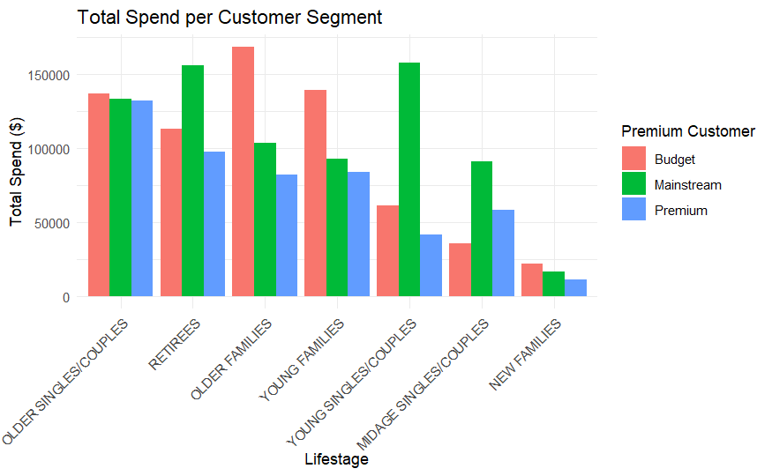
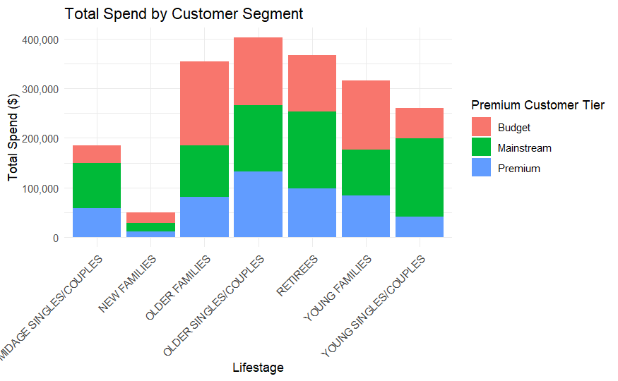
Executive Summary
Our analysis of transaction data reveals key customer purchasing behaviors that can drive strategic marketing decisions.
High spenders are primarily from the Young Singles/Couples and Older Families segments.

Slide 3
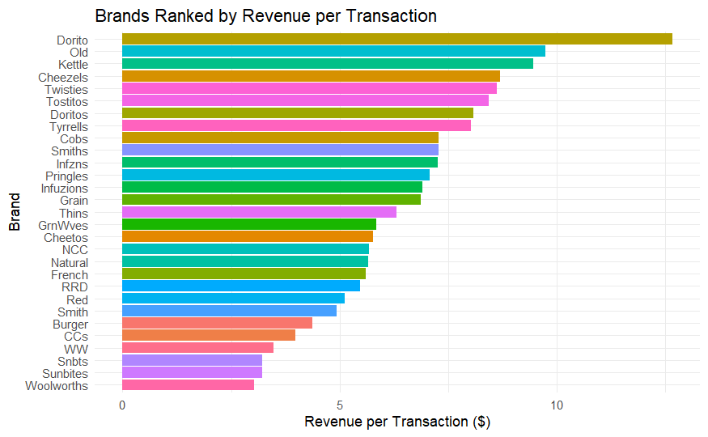
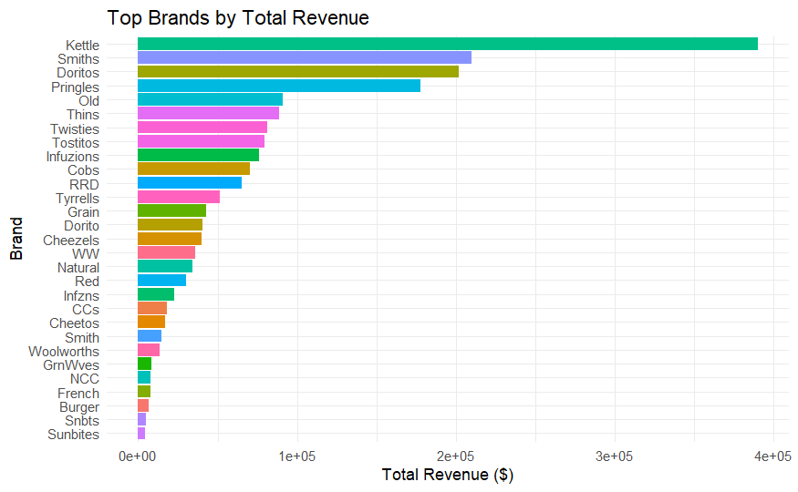
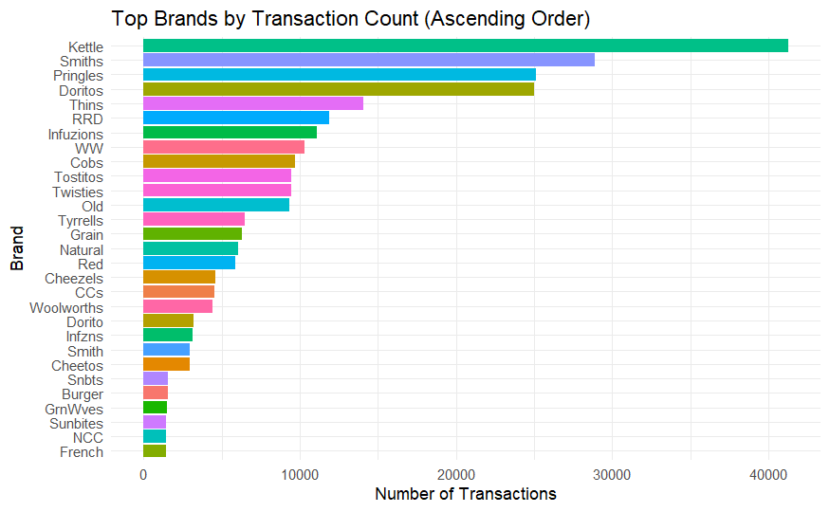
Executive Summary
The most purchased brands are Kettle, Smiths, and Doritos.
If ranked by Revenue per Transaction however, then top profits lies in Dorito, Old, and Kettle

Slide 4
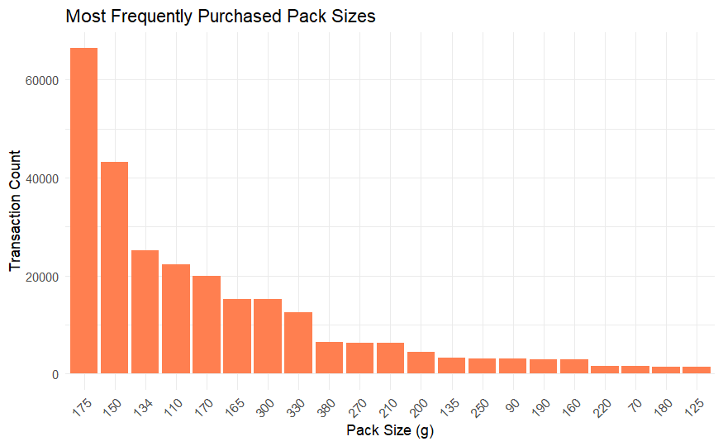
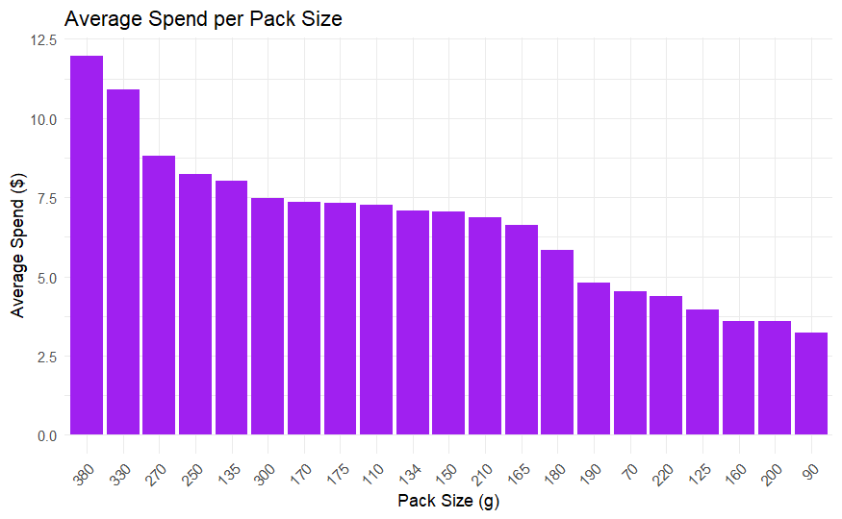
Executive Summary
175g pack size dominates total spend, indicating consumer preference for this size.

Slide 5
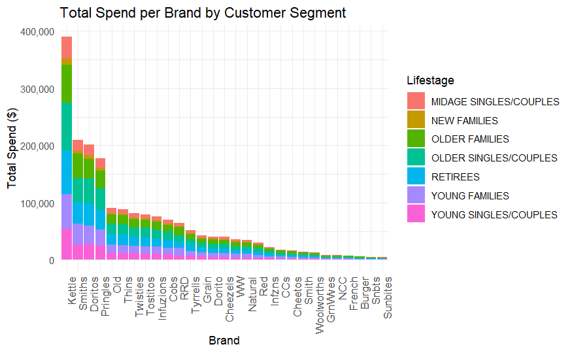
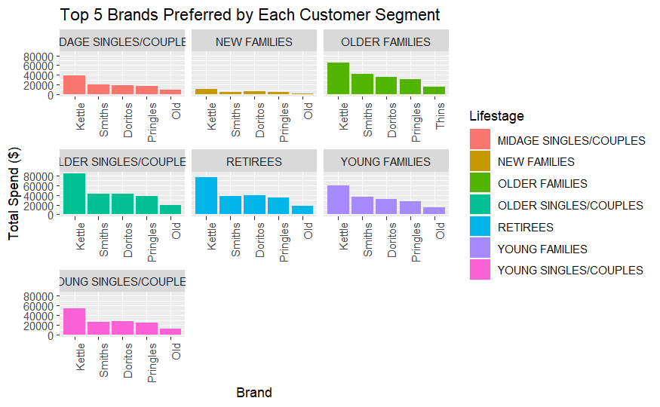
Brand Preference by Segment
"Kettle, Smiths, and Doritos are the most purchased brands across all customer segments.“
"Older Singles/Couples show a preference for premium brands, while Young Families lean towards budget-friendly options."

Slide 6
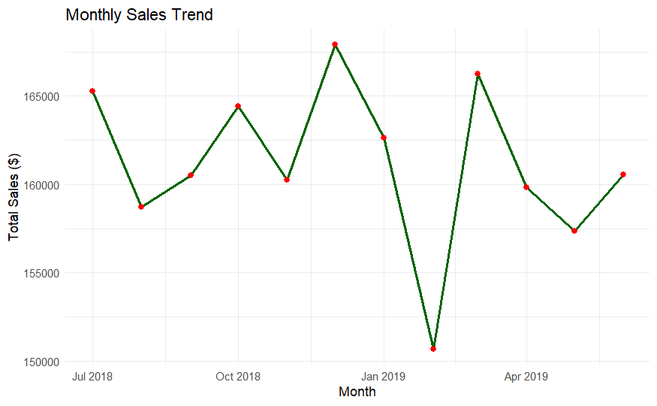
Monthly Insights
Insights
Highest in Jan 2019 and Apr 2019
Sharp drop in Feb 2019, suggesting possible seasonal or external factors
Sales remain relatively stable between 155,000 - 170,0004. Sales drop significantly in Feb 2019, potentially due to post-holiday demand drop.

Slide 7
Trial Uplift Analysis
Data-Driven Insights on Customer Behavior

Slide 8
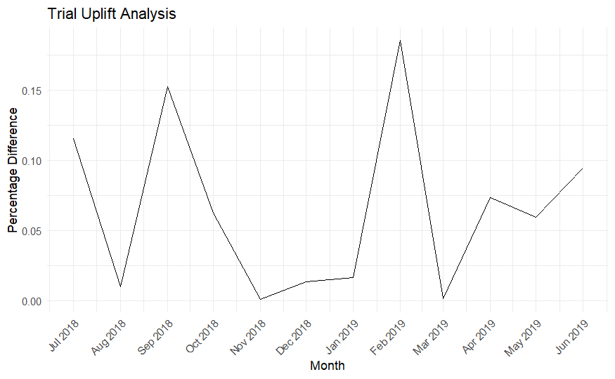
Executive Summary
Volatility appears too high, external factors may have heavily influenced the trial’s success.
Sustaining uplift beyond peak months is a challenge.
Investigate what happened in September 2018, February 2019, and March 2019 to understand the causes behind the fluctuations.

